Slide 1
What is Going On? Global Financial Turmoil
Frank Howland
Wabash College
2 October 2008

Slide 2
Executive Summary
Modern capitalist economies are prone to financial crises
The current crisis was caused by the housing bubble, excessive leverage, and poor regulation
The crisis is in essence a series of bank runs, reflecting a general lack of confidence in the financial sector
The “bailout” is designed to improve the capital position of banks in order to restore confidence
The crisis will worsen the recession because less credit means less investment

Slide 3
Outline
General and Specific Causes of the Crisis
  Important themes in finance: balance sheets, leverage, asymmetric information
Chronology
Policy Options
The Outlook

Slide 4
General Causes
Mismatch of financial institutions’ assets and liabilities on the balance sheet
Leverage (how much you borrow) increases fragility of the banking system
Asymmetric information

Slide 5
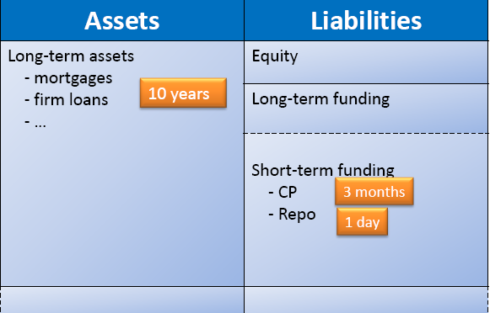
Maturity mismatch of financial institutions’ assets and liabilities
Source: Brunnermeier (2008)
Notes:
In the run-up to the current crisis: short term funding is kept very cheap by the Fed; long-term funding is quite expensive because you can’t take your money out quickly. By 2007, overnight funding via the repo market became 25% of assets.

Slide 6
Low Leverage
Suppose I can borrow at 3% and lend at 4%
I have $1 billion in capital
If I borrow another $1 billion, I can lend out $2 billion, receive $80 million in interest, pay $30 million in interest and net $50 million per year (5% return)
If 5% of the loans default, I suffer $100 million in default losses. So I lose $50 million (-5% return)

Slide 7
High Leverage
Suppose I can borrow at 3% and lend at 4%
If I borrow $29 billion, I can make $30 billion in loans.
  Interest expense: 3% x $29 billion = $0.87 billion
  Interest income: 4% x $30 billion = $1.20 billion
  Net revenue = $330 million (33% return)
If 5% of loans default, I lose on net $1.17 billion (-117% return)

Slide 8
Leverage’s Effects
Leverage increases expected returns at the cost of greater risk.
If the bank you own has negative net worth, your incentive is to borrow a lot of money. Heads you win, tails your creditors lose.
Regulators should recognize this and shut you down.

Slide 9
Asymmetric Information
Adverse selection: bad risks are the ones who accept your offer (what happens before the transaction). Applies to insurance, but also loans
Moral hazard: the risk that the other party will engage in activities that are undesirable (after the transaction). Closely related: principal-agent problems.

Slide 10
Asymmetric Information
Banks solve the adverse selection problem by specializing in figuring out who is a good risk.
Debt is preferred to stock as a means of dealing with moral hazard. Short-term debt is better still, as you can get out quickly.
Deposit insurance causes moral hazard problems. Depositors have no need to monitor bad banks; bad banks have continued access to funds.

Slide 11
Consequences: Recurring Bank Crises
United States Bank Panics: 1819, 1837, 1857, 1873, 1884, 1893, 1907, 1930-33
Mexico, 1994-95
East Asian Crisis, 1997-98
Source: Mishkin (2003)

Slide 12
Consequences: Recurring Bank Crises
The Five Big Five Crises: Spain (1977), Norway (1987), Finland (1991), Sweden (1991,) and Japan (1992)
Other Banking and Financial Crises: Australia (1989), Canada (1983), Denmark (1987), France (1994), Germany (1977), Greece (1991), Iceland (1985), and Italy (1990), and New Zealand (1987), United Kingdom (1974, 1991, 1995), and United States (1984).
Source: Reinhart and Rogoff (2008)

Slide 13
Specific Causes
Housing boom and bust
Securitization
Recent evolution of investment banking: high leverage bets on housing
Poor regulation
GSE (Fannie Mae, Freddie Mac) involvement
Notes:
Possibly

Slide 14
Housing Boom and Bust
Source: http://macromarkets.com/csi_housing/sp_caseshiller.asp
Notes:
Peak reached in June 2006 at 226.09; May 2008 was 181.48. Futures markets expect index to fall further.

Slide 15
Securitization
Mortgage Backed Security (MBS): a security secured by a pool of mortgages.
Collateralized Debt Obligations (CDOs): financial instruments in which an institution creates a new series of assets by repackaging the cash flows received from a given pool of underlying assets (some of which might themselves be CDOs).
Source: http://www.econbrowser.com/archives/2007/06/cdos_whats_the.html

Slide 16
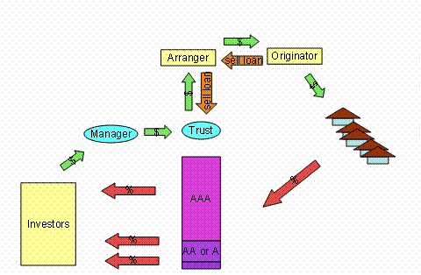
A complicated story
Source: http://www.econbrowser.com/archives/2008/01/mortgage_securi.html

Slide 17
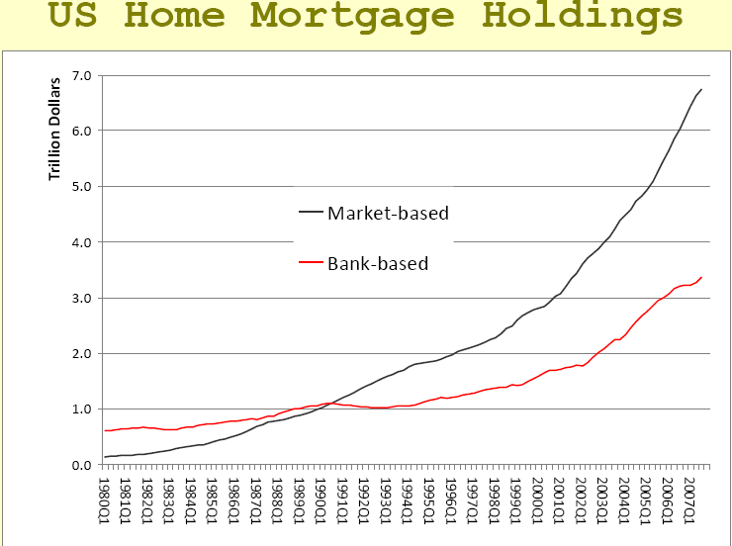
Source: Shin (2008)

Slide 18
Evolution of Investment Banking
Continuation of dot‐com bubble
Same banks made lots of money during dotcom era hyping and selling over‐inflated stocks
End of dot‐com bubble, scarred Main Street who didn’t want to borrow despite low interest rates
I-Banks needed new revenue stream to satisfy shareholders
Source: Hong, Harrison (2008)
Notes:
This is almost exactly what Hong said.

Slide 19
Poor regulation
SEC allows I-Banks to increase leverage
Credit default swaps are hardly regulated
In general, not enough transparency
Fed does not discourage subprime loans
Notes:
Commodity Futures Modernization Act of 200 left OTC derivatives largely unregulated. Fuffie and Hu, 2008, p. 5. http://ssrn.com/abstract=11140869.

Slide 20
Who said this?
“Lenders have taken advantage of credit-scoring models and other techniques for efficiently extending credit to a broader spectrum of consumers. . . . [These models] have reduced the costs of evaluating the creditworthiness of borrowers, and in competitive markets, cost reductions tend to be passed through to borrowers. Where once more-marginal applicants would simply have been denied credit, lenders are now able to . . . judge the risk posed by individual applicants and to price that risk appropriately. These improvements have led to rapid growth . . . today subprime mortgages account for roughly 10 percent of the number of all mortgages outstanding.”
Notes:
Former Chairman Alan Greenspan of the US Federal Reserve Bank - Fourth Annual Community Affairs Research Conference Washington, D.C. April 8, 2005).

Slide 21
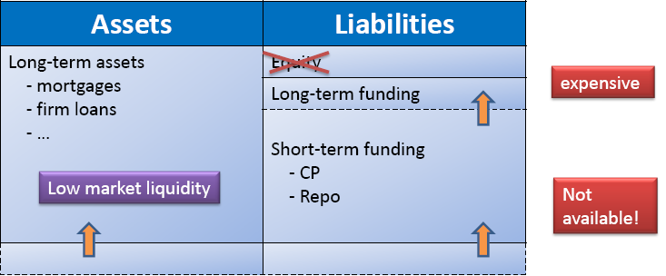
The Liquidity Spiral
Source: Brunnermeier (2008)
Notes:
osubprime crisis hits
oequity shrinks, volatility increases
oshort-term financing is harder to obtain No roll over (since margins/haircut widen)
oSell assets at fire-sale prices

Slide 22
Summary Chronology
Bear Stearns bails out one of its funds in June 2007.
Since August, 2007 Fed has extended enormous credit to the banking system in a variety of ways
Starting in March, 2008 all 5 major investment banks left the scene
The federal government has in effect nationalized a major insurance company (AIG) and most of the mortgage industry (Fannie Mae, Freddie Mac)
Major commercial banks have failed
European governments have rescued several banks and are proposing bailouts
Notes:
Note that IndyMac failure some uninusred depositors lost

Slide 23
September, 2008
Sept 7 Fannie Mae and Freddie Mac put into conservatorships
Sept 14 Merrill Lynch sold to Bank of America
Sept 14 Lehman Brothers files for bankruptcy
Sept 16 AIG rescued by $85 billion loan from Treasury in return for de facto federal control
Sept 16 Reserve Primary money market fund “breaks the buck”
Sept 18 Paulson proposes vast bailout
Sept 21 Goldman Sachs and Morgan Stanley announce plans to become bank holding companies
Notes:
Source: http://www.nytimes.com/interactive/2008/09/27/business/economy/20080927_WEEKS_TIMELINE.html. Mr. Lockhart said that by August, the firms’ borrowing costs were climbing higher and it became clear the firms wouldn’t be able to raise capital in any “meaningful size.” Meanwhile, central banks had stopped buying their securities, while ratings firms had notched down their ratings on all but the companies senior debt.
These factors “convinced us that the time to act was now,” he said.

Slide 24
Most Recent Chronology
Sept 25 Washington Mutual seized by FDIC; assets sold to JP Morgan Chase
Sept 28 Congress votes down Troubled Asset Relief Program (TARP); stock market falls 9%
Sept 28 Benelux nationalize Fortis; Brits seize mortgage lender Bradford & Bingley; German banks rescue mortgage lender Hypo
Sept 29 Wachovia sold to Citi Bank

Slide 25
Current conditions
Banks refuse to lend to one another and are only borrowing from central banks
Banks are having great difficulty selling CDOs. There is no market for these securities.
Bond markets: New debt issuance was $15.5 billion in September of this year compared with $101 billion in September of 2007.
Total commercial paper outstanding is down $for both financial and non-financial firms.
State and local governments are having difficulty borrowing.
Notes:
http://www.frbatlanta.org/invoke.cfm?objectid=B3C99FE6-5056-9F12-127F4982E2794934&method=display

Slide 26
Provisions of Bailout
  Up to $700 billion in financing for purchases of distressed securities
  Financial Stability Oversight Board gives Congress and its experts an advisory role
FDIC increases its insurance of bank deposits to first $250,000 of deposits
FDIC can borrow unlimited amounts from Fed
Affirm SEC’s ability to suspend “mark-to-market” accounting
Insurance scheme
All sorts of nonsense
Notes:
See: http://balkin.blogspot.com/2008/09/update-revising-powers-of-secretary-of.html

Slide 27
The Fine Print
Apart from the Troubled Assets Relief Program, the bill before the Senate includes:
Extensions of the AMT patch, tax deductions on state and local sales taxes, tuition, teacher expenses and real property taxes and tax credits for business research and new market investors
Energy tax credits and incentives to encourage wind and refined coal production, new biomass facilities, wave and tide electricity generators, solar energy property improvements, CO2 capturing, plug-in electric drive vehicles, idling reduction units on truck engines, cellulosic biofuels ethanol production, energy efficient houses, offices, dishwashers, clothes washers and refrigerators, and fringe benefits for employees commuting by bicycle.
A requirement for private insurance plans to offer mental health benefits on par with medical-surgical benefits
Tax relief provisions for victims of this summer's Midwestern floods, and Hurricane Ike
Freezing of deductions for sale and exchange of oil and natural gas, mandatory basis reporting by brokers for transactions involving publicly traded securities and an extension of the oil spill tax
But it also extends the following tax provisions:
Economic development credit to American Samoan businesses
$10,000 tax credit for training of mine rescue team members
50% immediate expensing for extra underground mine safety equipment
Tax credit for businesses with employees from an Indian reservation
Accelerated depreciation for property used mostly on an Indian reservation
50% tax credit for some expenditures on maintaining railroad tracks
7-year recovery period for motorsports racetrack property
Expensing of cleaning up "brownfield" contaminated sites
Enhanced deductions for businesses donating computers and books to schools, and for food donations
Deduction for income from domestic production in Puerto Rico
Tax credit for employees in Hurricane Katrina disaster area
Tax incentives for investments in poor neighborhoods in D.C.
Increased rehabilitation credit for buildings in Gulf area
Reduction of import duties on some imported wool fabrics, transfers other duties to Wool Trust Fund to promote competitiveness of American wool
Special expensing rules for film and TV productions
And there's more:
Increasing cover of rum excise tax revenues to Puerto Rico and the Virgin Islands
Making it easier for film and TV companies to use deduction for domestic production
Exempting children's wooden arrows from excise tax
Income averaging for Exxon Valdez litigants for tax purposes
Source: http://online.wsj.com/article/SB122286874792094117.html

Slide 28
Arguments for a bailout
We are in danger of full-scale bank run and possibly a liquidity trap in which the Fed cannot prevent prolonged deflation.
Thus confidence must be restored.
Government can purchase assets at their actual value, which is above current market value. This increases bank capital and confidence.
Notes:
(1) Bruce Bartlett: http://www.nypost.com/seven/09272008/postopinion/opedcolumnists/why_the_bailout__130927.htm?page=0

Slide 29
Arguments against this bailout
To be effective, the Treasury must overpay for the assets it purchases.
The bailout will support both good and bad banks, but bad banks must be shut down before they do further damage.
A better solution would be to buy part of the banks, thereby giving them badly needed capital. Private sector would handle the “troubled assets.”

Slide 30
Economists’ Views
Most agree confidence must be restored via government action.
Disagreement over role of liquidity vs. lack of capital (insolvency).
Disagreement over the appropriate remedy.
Many see need for Swedish style nationalization of the banks.

Slide 31
Consequences of the Crisis
Likely hit to economic growth via deleveraging. A sharper recession due to tighter credit, greater uncertainty, lower wealth.
Bailout may cause interest rates to rise, dollar to drop.
Unlikely but worrisome: Great Depression type reduction in credit to real economy
Creative destruction: financial sector declines, goods-producing export sector grows.

Slide 32
Implications for personal finance
Long term savings picture unchanged: for most people the best vehicle is still broadly diversified, domestic and international, stock funds combined with bond and inflation-protected bond mutual funds.
Human capital: develop flexible skills.

Slide 33
References
Brunnermeier, Markus (2008). “Thoughts on a New Financial Architecture,” Slides from Princeton Forum Sept 23, 2008.
Hong, Harrison (2008) - How We Got Here and Some Lessons? Slides from Princeton Forum Sept 23, 2008
Mishkin, Frederic. Financial Institutions and Markets, 4th Edition, 2003.
Reinhart, Carmen and Kenneth Rogoff (2008). “Is the 2007 U.S. Sub-Prime Financial Crisis So Different? An International Historical Comparison”
Shin, Hyun (2008). - Crisis on Wall Street Slides from Princeton Forum Sept 23, 2008.

